Slide 1
Is quality worth the cost?
Source: Is High Quality Software Worth the Cost? (martinfowler.com)

Slide 2
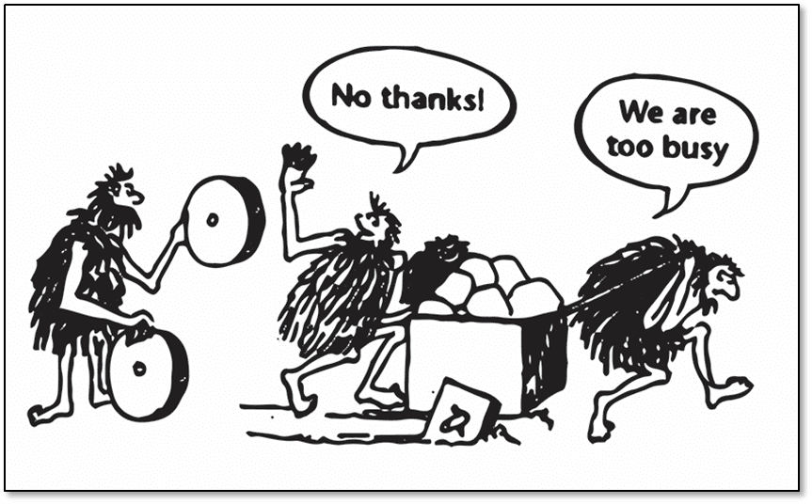

Slide 3
Software quality
Internal quality
Module structure
Software architecture (MVVN)
Software design (SOLID, yagni etc.)
Tests
External quality
What the customer currently sees and feels
Notes:
Software quality is not seeable from a users perspective. Its the developer who needs to cope with it.

Slide 4
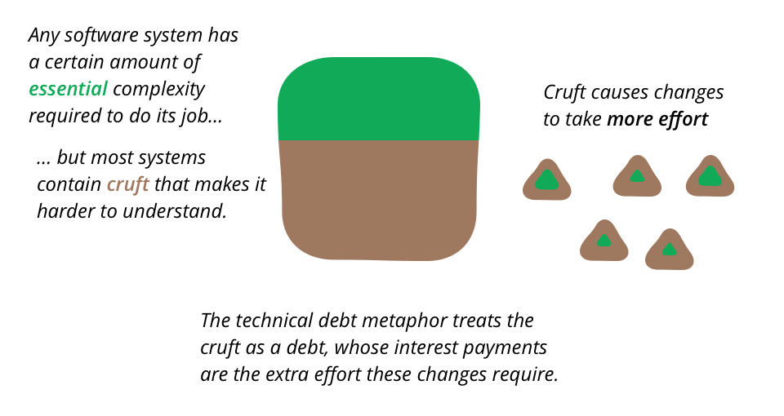
Cruft (überflüssiger Müll / nutzloser Code)
Notes:
(überflüssiger Müll / nutzloser Code)

Slide 5
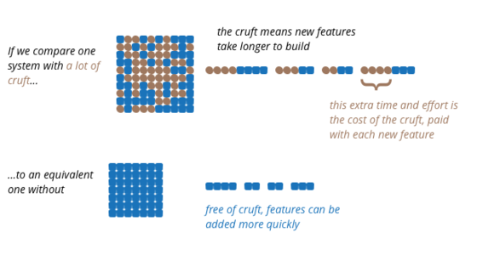
Complexity slows you down

Slide 6
Signs of cruft
Velocity decreases over time
Developers are not happy
Bugs are recurring
Solving one problem opens another problem
Long lasting enforced refactorings
Notes:
Wir drehen uns um uns selbst

Slide 7
The mistake
Stacking up technical debts because feature x is more important
Because it would cost = x + tech. debt
But if you would have fixed your tech. debt, you would have immediate effect and implement feature x faster and improved code for feature y already.
Notes:
WISJIF

